Slide 1

JSS COLLEGE OF ARTS COMMERCE AND SCIENCE DEPARTMENT OF COMPUTER SCIENCE A PROJECT PRESENTATION ON - DSMS
By,
Ravi Raghavendra G S (U01BE21S0105)
VI Semester BCA
Under the Guidance of,
Jayashree H J
Assistance Professor
Department Of Computer Science
JSSCACS Mysore.

Slide 2
DAIRY SERVE MANAGEMENT SYSTEM (DSMS)
A Comprehensive Solution for Dairy Business Management

Slide 3
INDEX
SL.NO | CONTENT | SLIDE NUMBER
1 | INTRODUCTION | 4
2 | REQUIREMENT SPECIFICATION | 7
3 | APPLICATIONS | 9
4 | SYSTEM DESIGN | 10
5 | SNAP SHOTS | 15
6 | CONCLUSION | 17
7 | FUTURE ENHANCEMENTS | 18
8 | BIBLIOGRAPHY | 19

Slide 4
INTRODUCTION
1. Dynamic Landscape of Dairy Farming :
Efficiency in management systems is crucial for productivity, sustainability, and profitability.
2. Purpose of DSMS :
The Dairy Serve Management System (DSMS) modernizes dairy farm operations.
Provides a comprehensive platform to streamline various facets of dairy management.
3. Evolving Market Demands :
As dairy farms evolve, the need for a robust, integrated system becomes crucial.
DSMS offers a centralized solution for optimizing processes and enhancing productivity.
4. Technological Empowerment :
Overcomes challenges of traditional management systems like manual record-keeping and inefficient workflows.
Leverages technology for automation, real-time data analytics, and intuitive interfaces.
5. Revolutionizing Dairy Operations :
Drives efficiency, agility, and sustainability in dairy farming.
Facilitates informed decision-making for farm owners and managers.
6. Setting the Stage :
Introduction highlights the functionalities, benefits, and implementation of DSMS.
Emphasizes DSMS's pivotal role in shaping the future of dairy farming.
7. Clear Objective :
Clearly state the objective of the project. For example, "To streamline dairy business operations through efficient data management and user-friendly interfaces."

Slide 5
Objective of the Project
Administrative Efficiency: Streamline administrative tasks such as attendance tracking, inventory management, and staff scheduling.
Operational Optimization: Enhance daily operations by automating routine tasks and integrating data across various modules.
Data Management: Provide a centralized platform for storing, updating, and retrieving information related to farmers, staff, dairy animals, and products.
Financial Management: Simplify billing, payroll, and financial reporting processes.
Customer Interaction: Improve customer experience through efficient order management and support systems.
Scope of the Project
Registration and Enrollment: Manage the registration and enrollment processes for farmers, staff, and customers.
Farm and Animal Details: Maintain comprehensive records of farm details, dairy animals, and their health.
Daily Data Entry: Record daily milk production, quality parameters, and other essential data.
Product Management: Track inventory, manage product details, and monitor stock levels.
Billing and Payments: Handle billing, payment processing, and generate invoices for transactions.
Order Management: Manage order placement, processing, and tracking for both offline and online orders.

Slide 6
Existing System
Manual Data Entry: Conventional methods involve paper-based and manual operations for recording dairy data.
Inefficient Data Management: Searching for specific records, such as farmer details or inventory lists, is time-consuming and prone to errors due to manual processes.
Limited Integration: Various aspects of dairy management, such as billing, inventory, and staff scheduling, are not integrated, leading to fragmented operations.
Lack of Real-Time Data: Current systems do not provide real-time data analytics, making it difficult to monitor and make timely decisions.
Report Generation: Generating reports is cumbersome and limited due to the reliance on paper records.
Resource Management: Manual tracking of resources such as feed, medical supplies, and equipment is inefficient and prone to errors.
Customer Interaction: Handling customer orders and feedback is slow and unorganized, affecting overall customer satisfaction.
Proposed System
Web-Based Application: Develop a web-based application to provide necessary services and streamline dairy management processes.
User-Friendly Interface: Design an intuitive interface for ease of use by farmers, staff, and administrators.
Data Entry: Automate the process of recording and managing data, reducing the reliance on paper and minimizing errors.
Integrated Management: Integrate various modules such as billing, inventory, staff scheduling, and customer orders into a single platform for seamless operations.
Enhanced Customer Interaction: Facilitate efficient handling of customer orders, feedback, and support through a centralized system.
Easy Search and Retrieval: Enable easy searching and retrieval of records using basic features such as names, dates, and categories.

Slide 7
Requirement Specification
Functional Requirements:
User Registration: Users (farmers, staff, and buyers) can register on the Dairy Serve Management System website.
User Login: Users can log in using their username and password.
Dashboard Access: Provide personalized dashboards for different user roles (admin, staff, farmers, buyers).
Data Management: Allow users to add, update, and delete data related to farmers, staff, dairy animals, products, and orders.
Inventory Management: Track and manage dairy products, feed, and supplies inventory levels.
Order Placement and Management: Facilitate placing, processing, and tracking orders for dairy products.
Billing and Payments: Handle billing and payment processes, including generating invoices.
Notifications and Alerts: Send automated notifications and alerts for important events (e.g., new product updates, payment due dates).
Customer Feedback and Reviews: Collect and manage customer feedback and reviews.
Non-Functional Requirements:
Scalability: The system should be able to handle an increasing number of users and data without performance degradation.
Availability: Ensure the system is available 24/7 with minimal downtime.
Maintainability: Design the system to be easily maintainable and upgradable.
Performance: Ensure the system performs efficiently with fast response times for user interactions.
Security: Implement robust security measures to protect user data and ensure secure transactions.

Slide 8
Hardware Requirements
- Processor: Intel Core i3 3rd generation 2.4 GHz or higher
- Hard Disk: 200 GB or more
- RAM: 4 GB onwards
Software Requirements
- Operating System: Windows 7 or later
- Technology Used : HTML, CSS, Bootstrap (Frontend); PHP, MySQL (Backend)
- Database : MySQL 5.7
- IDE: Visual Studio code
- Version Control: Git (GitHub)

Slide 9
MODULES AND FEATURES
Admin Module
Manage Farmers
Add, update, delete, and view farmer details.
Manage Staff
Add, update, delete, and view staff details.
Manage Products
Add, update, delete, and view dairy products.
View Reports
Generate and view various operational reports.
Generate Bills
Generate billing statements for farmers and buyers.
2. Farmer Module
Dashboard
Overview of farmer-related data.
View Farmer Details
Access personal details and update information.
View Dairy Animal Details
View and manage details of dairy animals.
View Daily Data Entries
Access records of daily milk production and other relevant data.
Add Daily Data Entries
Input daily milk production data and other relevant details.
3. Staff Module
Dashboard
Overview of staff-related data.
View Staff Details
Access personal details and update information.
Generate Bills
Assist in generating billing statements.
View Dairy Animal Details
View and manage details of dairy animals.
View Daily Data Entries
Access records of daily milk production and other relevant data.
Add Daily Data Entries
Input daily milk production data and other relevant details.
4. Buyer Module
Dashboard
Overview of available products and orders.
View Products
Browse and view available dairy products.
Place Order
Order dairy products online.
View Order History
Access previous orders and order statuses.
Make Payment
Secure payment processing through Razorpay.
Receive Invoice
Obtain digital invoices for orders.

Slide 10
5. Common Features
Authentication and Authorization
Secure login and role-based access control.
Notifications System
Notify users of important updates and actions.
Profile Management
Manage and update user profiles.
Communication Module
Facilitate communication between users and the admin.
Reports Module
Generate various operational reports.
Inventory Management
Track and manage dairy inventory.
Feedback and Reviews
Collect and manage feedback and reviews from users.
Support Module
Provide customer support and helpdesk functionalities.
6. Razo pay Integration
Secure Payment Gateway
Enable secure online payments for buyers.
Order Management
Manage orders and payment verifications.
Payment Management
Process and verify offline and online payments.
Invoice Generation
Automatically generate and email invoices upon payment.

Slide 11
Applications of Dairy Serve Management System
Farm Management : Streamline daily operations and resource allocation.
Financial Management: Automate billing, invoicing, and expense tracking.
Inventory Management: Track dairy products and manage supply chains.
Customer Relationship Management: Efficiently handle orders and customer feedback.
Human Resource Management: Manage staff schedules, attendance, and payroll.
Data Analytics and Reporting: Monitor performance and generate compliance reports.
Sustainability: Optimize resource use and track waste management.
Marketing and Sales: Promote products and analyze sales data.
Mobile Accessibility: Manage operations remotely with real-time updates.
Compliance and Auditing: Maintain audit trails and generate regulatory reports.

Slide 12
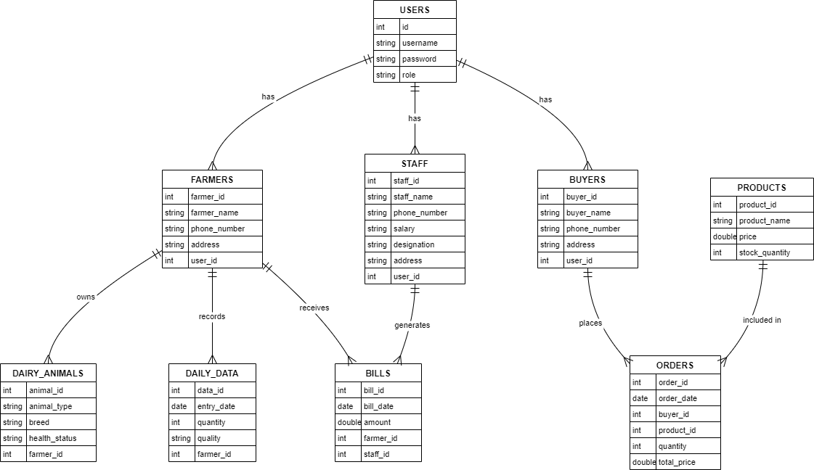
SYSTEM DESIGN
CLASS DIAGRAM

Slide 13
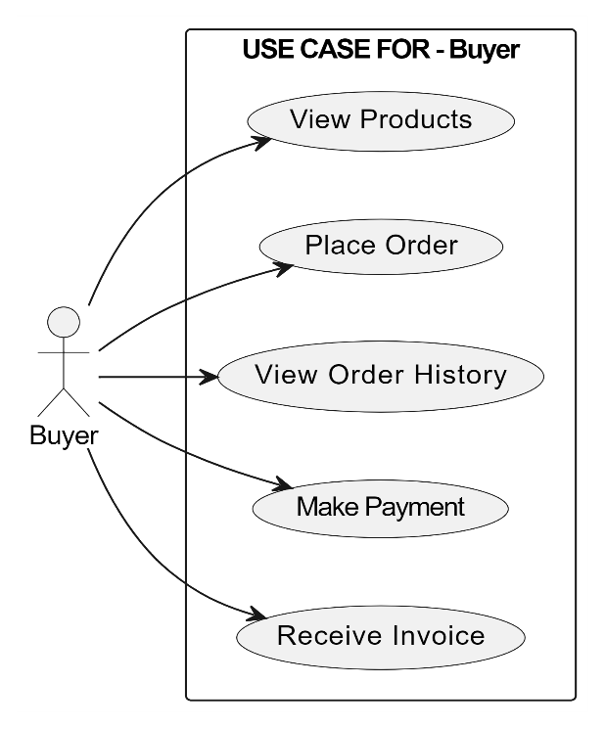
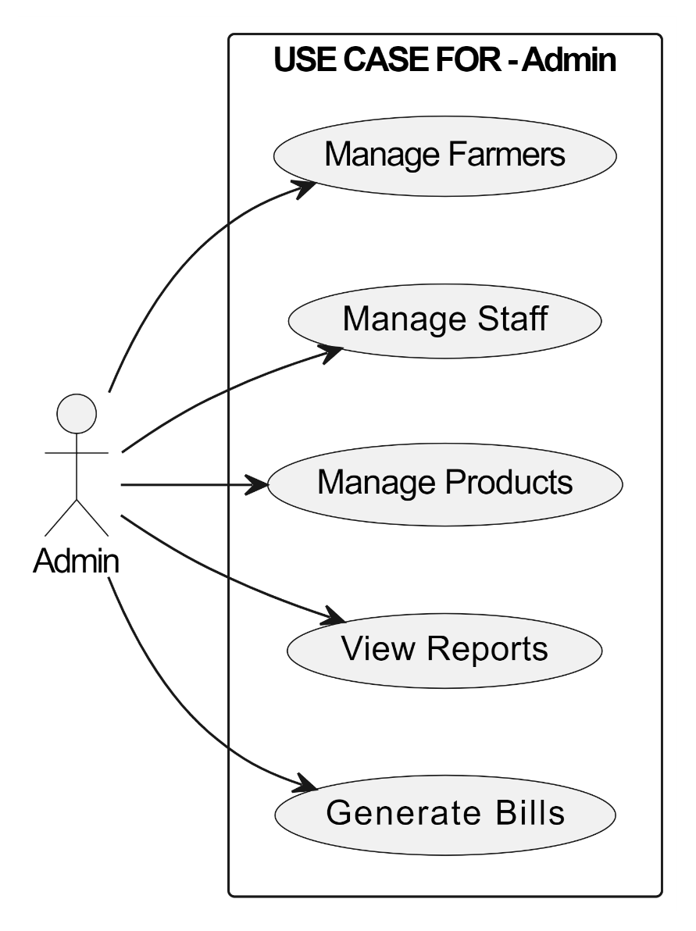
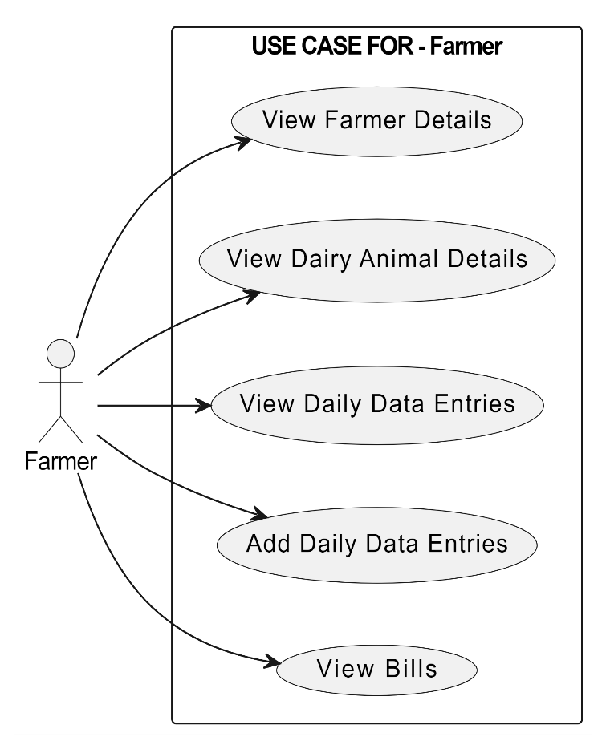
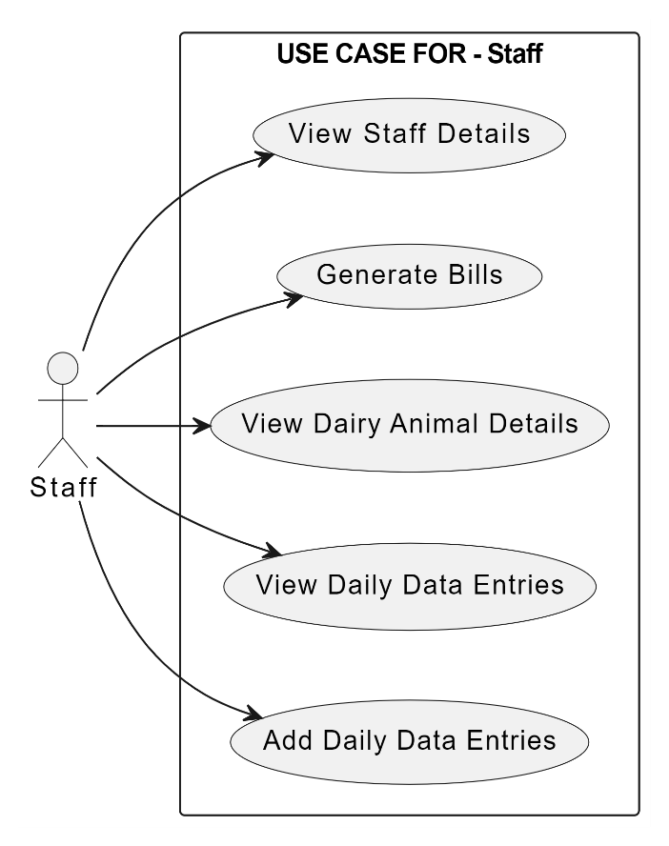
USE CASE FOR ALL PRIVILEGES

Slide 14
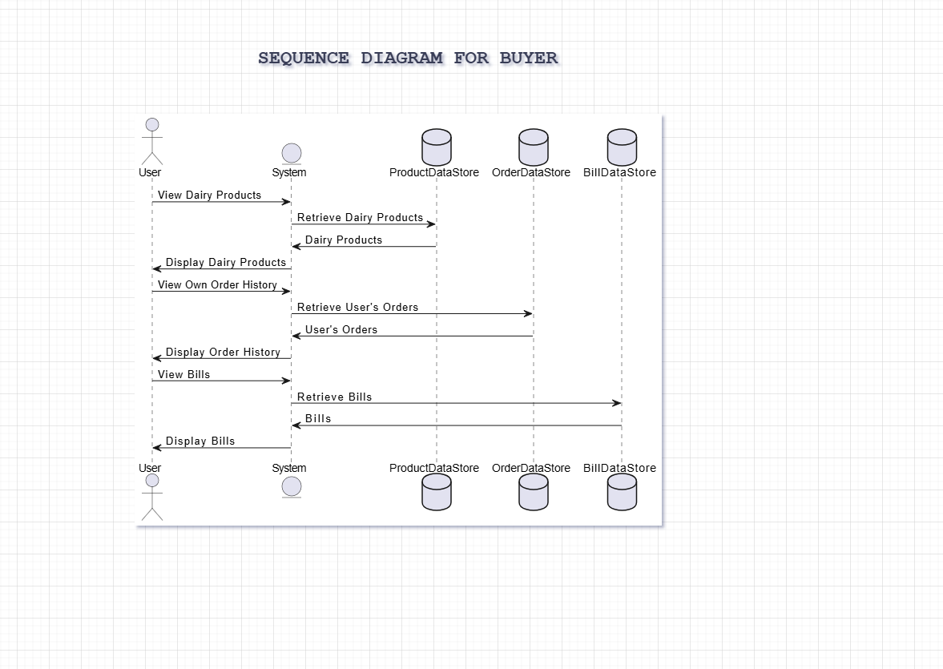

Slide 15
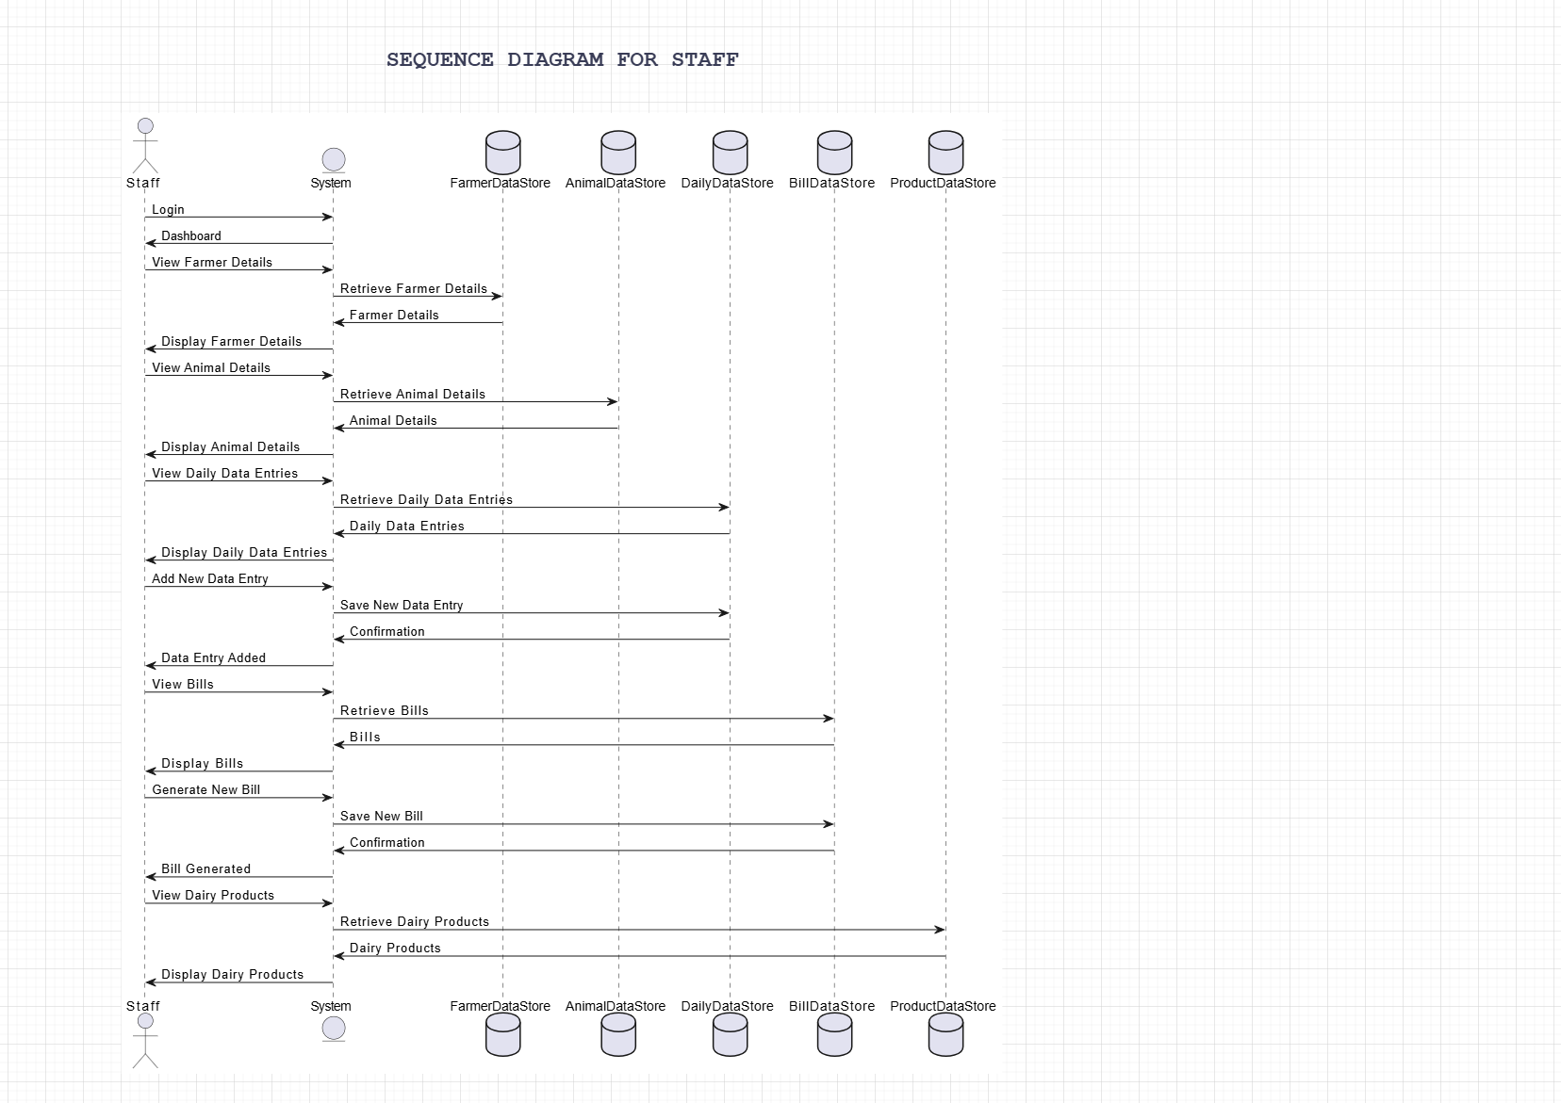

Slide 16
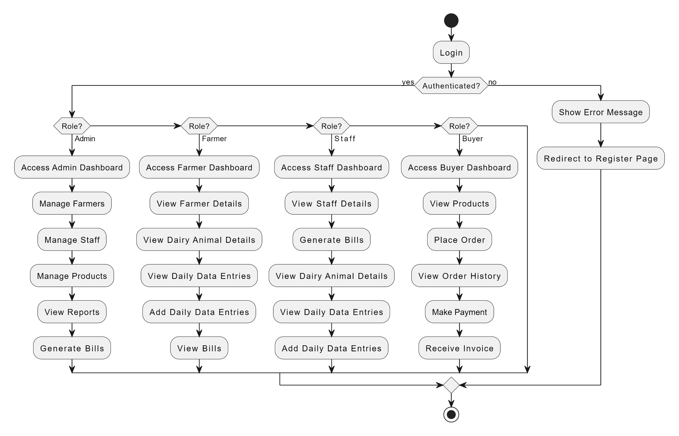
ACTIVITY DIAGRAM

Slide 17
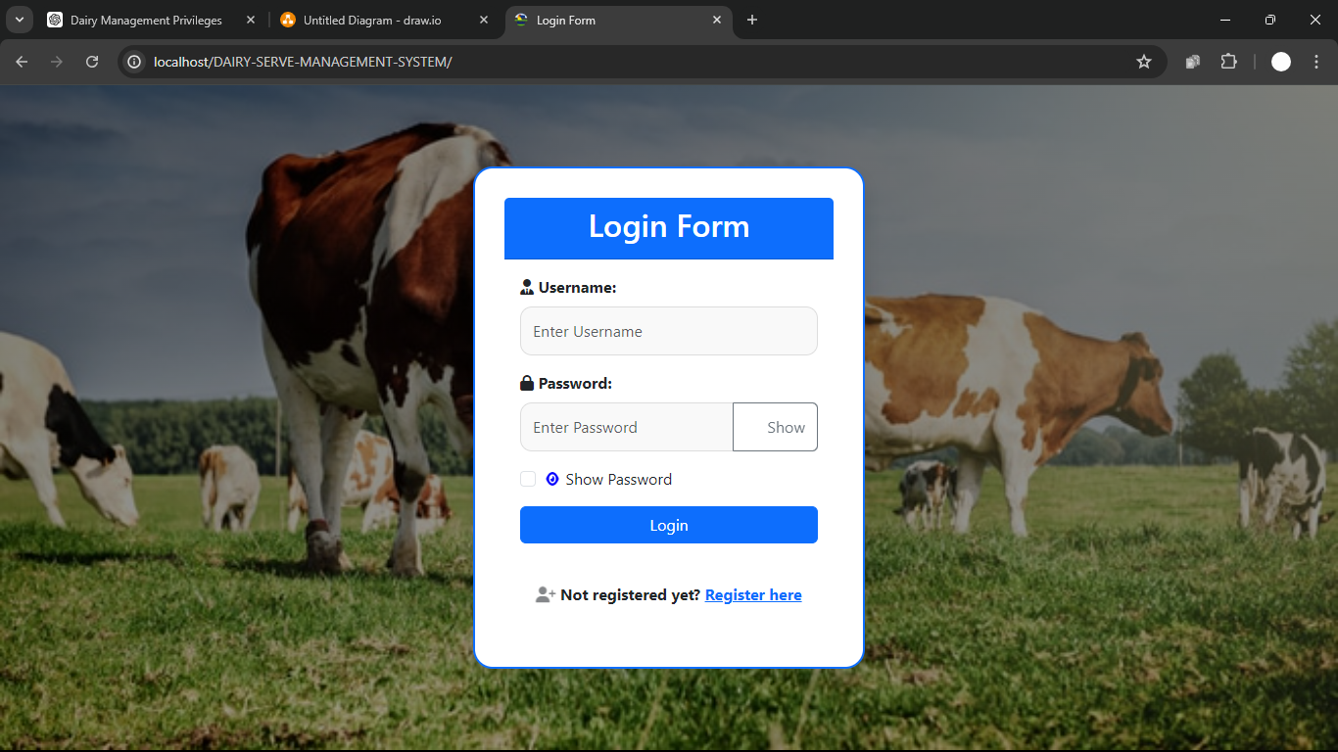
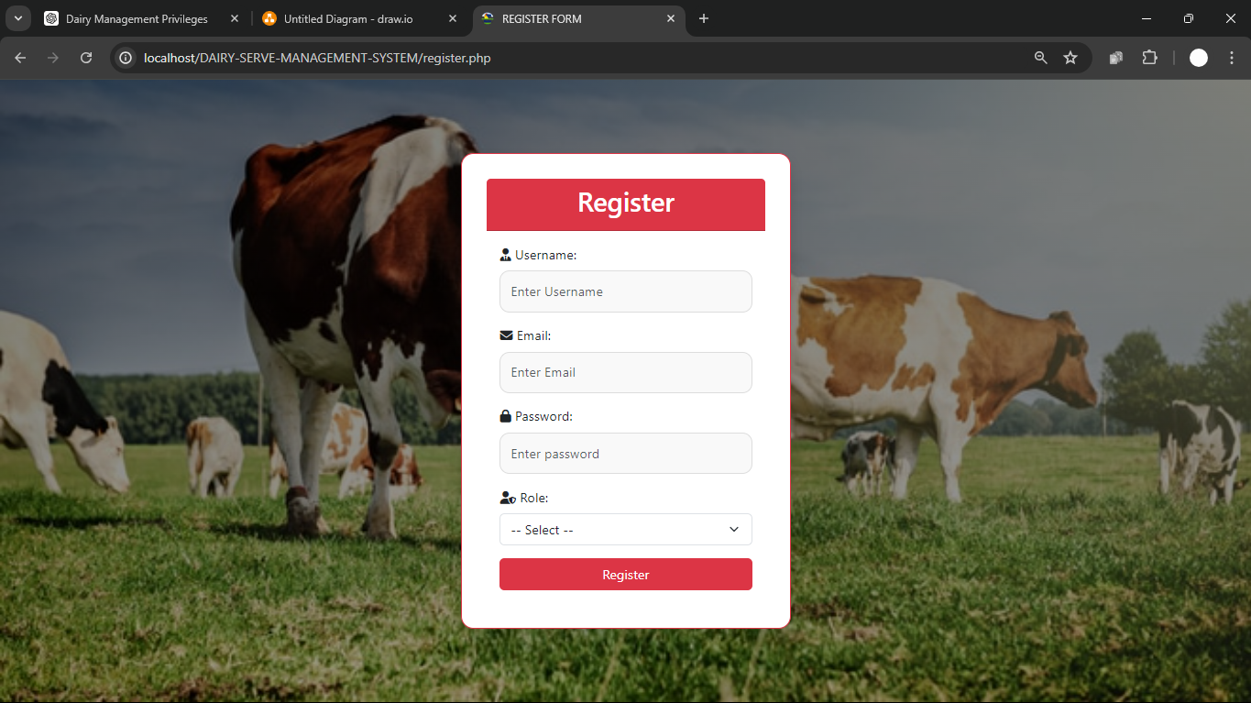
SNAP SHOTS
LOGIN PAGE
REGISTERATION PAGE

Slide 18
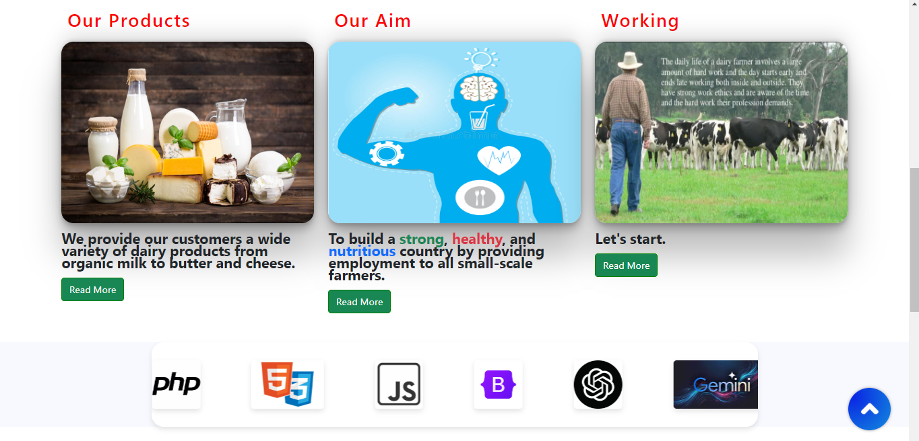
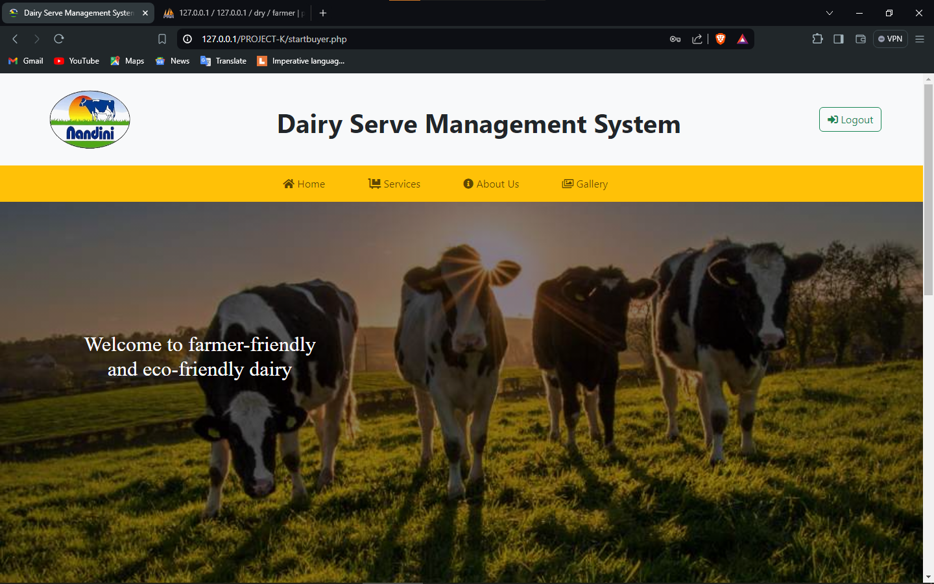
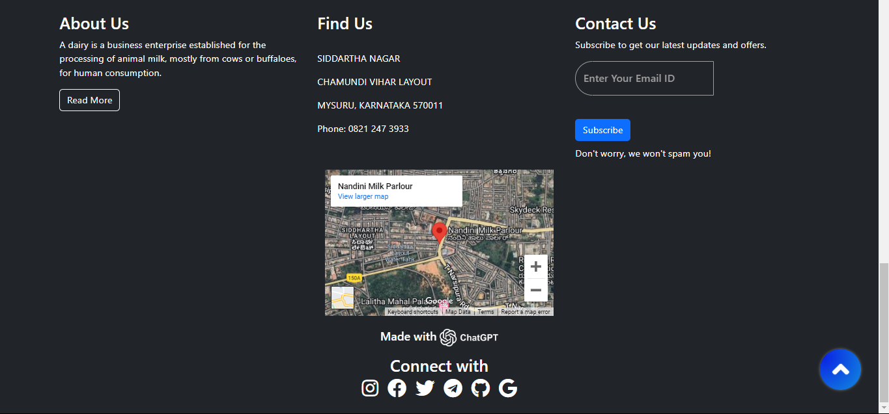
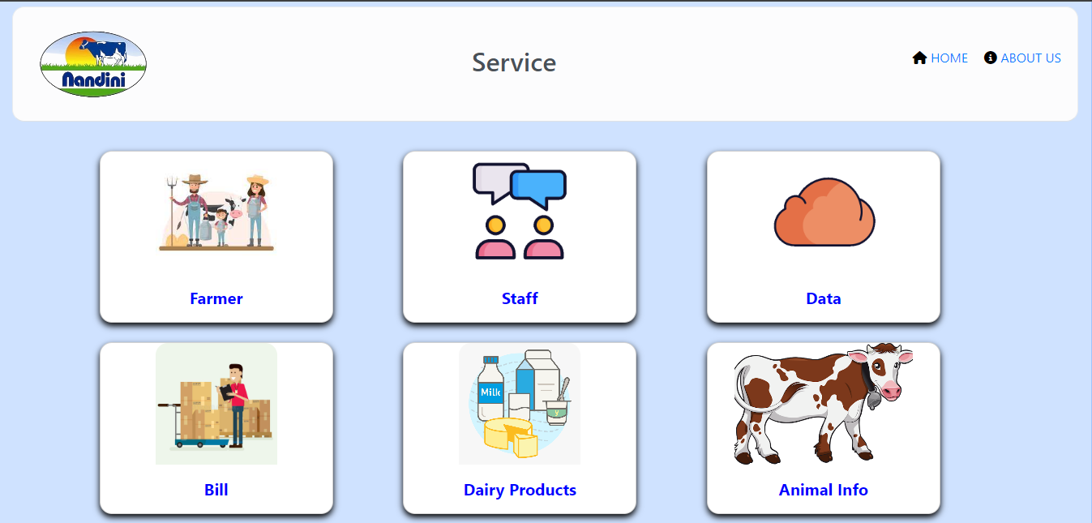
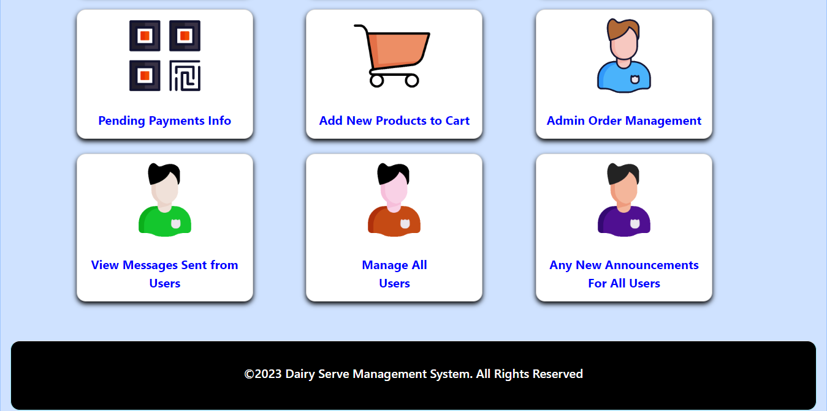
ADMIN DASHBOARD
ADMIN SERVICE PAGE

Slide 19
CONCLUSION
In conclusion, the Dairy Serve Management System represents a significant advancement in the field of dairy business management. By incorporating essential modules for every aspect of dairy operations, it ensures streamlined processes, accurate data handling, and improved efficiency. The system's design prioritizes ease of use, making it accessible for all users, from farmers to administrators. Looking ahead, we plan to enhance the system further, integrating more advanced features and adapting to the evolving needs of the dairy industry. This project not only demonstrates the practical application of our technical skills but also highlights our commitment to creating impactful solutions for real-world problems. Thank you for your attention and interest in our Dairy Serve Management System.

Slide 20
FUTURE ENHANCEMENTS
Every application has its own merits and demerits, and the Dairy Serve Management System (DSMS) is no exception. While the project has successfully covered almost all the current requirements, there is always room for further development and improvement. The structured and modular nature of the coding allows for easy modifications and the addition of new modules.
Future enhancements to DSMS could focus on making the application even more attractive and useful. This can include:
Enhanced User Interface: Improving the visual design and user experience to make the application more intuitive and appealing.
Mobile Compatibility: Developing a mobile-friendly version of the application to ensure seamless access on smartphones and tablets.
Enhanced Security: Continuously updating and enhancing security features to protect sensitive data and ensure compliance with industry standards.

Slide 21
BIBLIOGRAPHY
The Dairy Serve Management System (DSMS) has been developed with support from various references and resources. Here is a list of the materials and sources consulted during the project:
URL REFERENTIAL
Websites:
W3Schools. (2024). PHP Tutorial. Retrieved from https://www.w3schools.com/php/
Apache Friends. (2024). XAMPP Installation Guide. Retrieved from https://www.apachefriends.org/index.html
Bootstrap. (2024). Introduction to Bootstrap. Retrieved from https://getbootstrap.com/docs/5.0/getting-started/introduction/
Online Tutorials and Documentation:
PHP Documentation. (2024). PHP Manual. Retrieved from https://www.php.net/docs.php
FPDF Manual. (2024). FPDF: Free PDF Library. Retrieved from http://www.fpdf.org/
AI Assistance:
OpenAI. (2024). ChatGPT: Your virtual assistant for project development and more. OpenAI. Retrieved from https://www.openai.com/chatgpt
Gemini. (2024). Gemini: Enhance your project development experience with AI. Gemini. Retrieved from https://www.gemini.com

Slide 22
